Slide 1



DIYALA UNIVERSITY
COLLEGE OF ENGINEERING
DEPARTMENT OF COMMUNICATIONS ENGINEERING
Mathematics- II
$$3^{rd }Lecture$$
First Year
lecturer
Wisam Hayder
2021

Slide 2
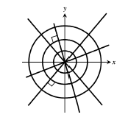
Applications
Ex. 1 : Find the orthogonal trajectories of the family of curves.
y = mx
Sol.

Slide 3
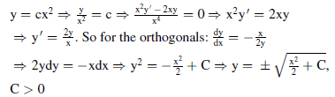
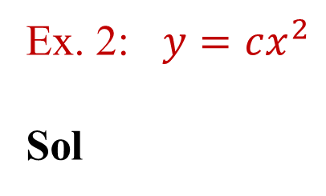
Applications
Ex. 2: $y=cx^{2}$
Sol

Slide 4
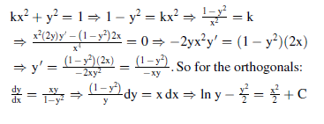
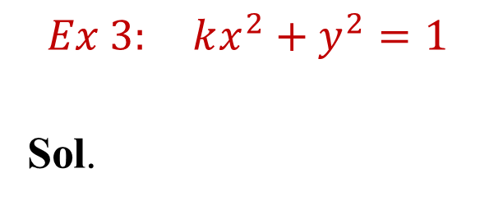
Applications
$$Ex 3: kx^{2}+y^{2}=1$$
Sol.

Slide 5
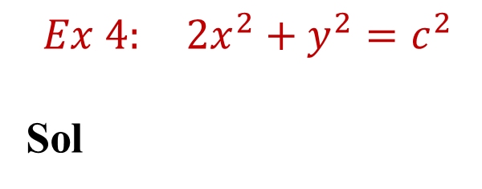
Applications
$$Ex 4: 2x^{2}+y^{2}=c^{2}$$
Sol
For orthogonals :

Slide 6

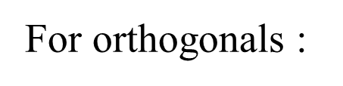
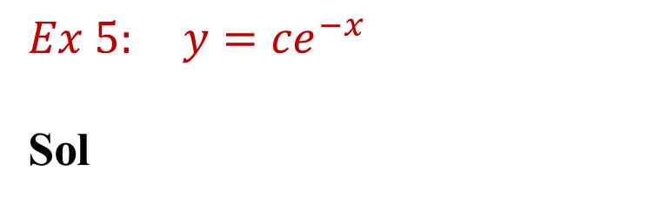
Applications
$$Ex 5: y={ce}^{−x}$$
Sol

Slide 7
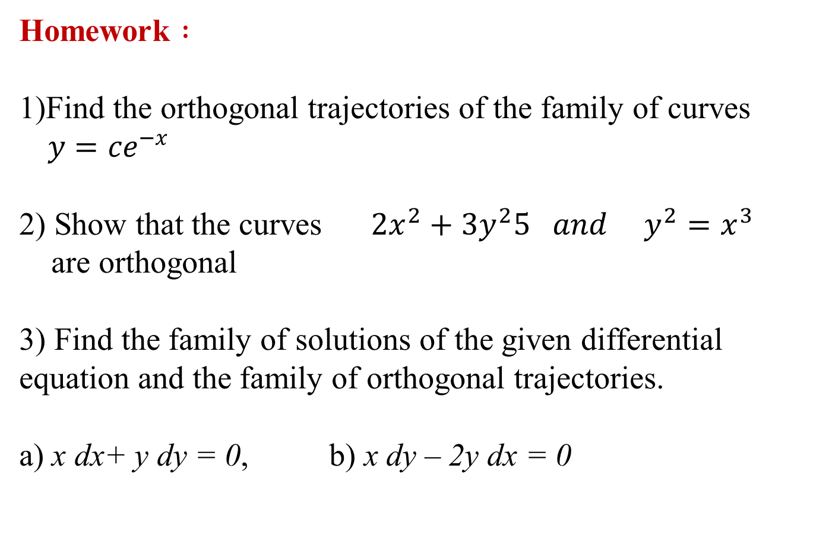
Applications
Homework $:$
1)Find the orthogonal trajectories of the family of curves $y={ce}^{−x}$
2) Show that the curves $2x^{2}+{3y}^{2}5 and { y}^{2}=x^{3}$
are orthogonal
3) Find the family of solutions of the given differential equation and the family of orthogonal trajectories.
a) x dx+ y dy = 0, b) x dy – 2y dx = 0

Slide 8
First-Order Differential Equations
Ordinary Differential Equations
Ordinary Differential Equations are equations involve derivatives.
First Order D.Eqs.
1- Variable Separable.
2- Homogeneous.
3- Linear.
4- Exact.
Notes:
aaa

Slide 9


1- Variable Separable:
A first order D.Eq. can be solved by integration if it is possible to collect all y terms with dy and all x terms with dx, that is, if it is possible to write the D.Eq. in the form
then the general solution is:

Slide 10
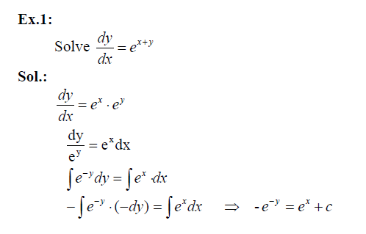
First-Order Differential Equations
Notes:
aaa

Slide 11
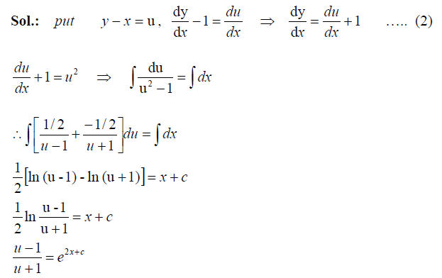
First-Order Differential Equations
Ex.2:
Notes:
aaa

Slide 12
First-Order Differential Equations
2- Homogeneous:
Some times a D.Eq. which variables can't be separated can be transformed by a change of variables into an equation which variables can be separated.
This is the case with any equation that can be put into form:

Slide 13
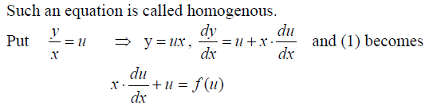

Slide 14
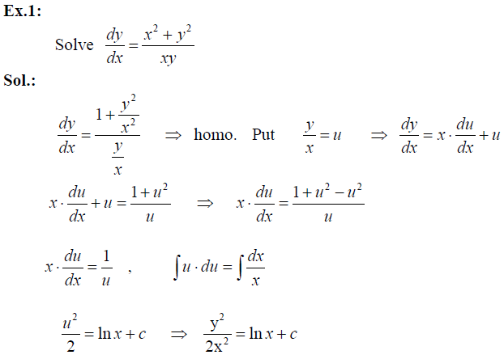
First-Order Differential Equations
Notes:
aaa

Slide 15
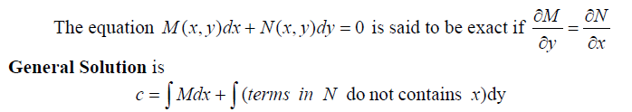

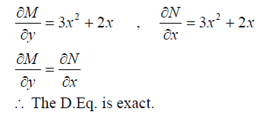
First-Order Differential Equations
4- Exact
Notes:
aaa

Slide 16
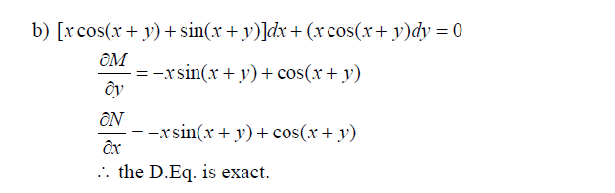
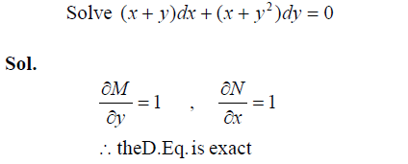
First-Order Differential Equations
Ex.2:
Notes:
aaa

Slide 17
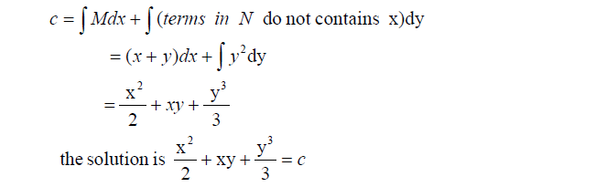
First-Order Differential Equations
Notes:
aaa

